Slide 1
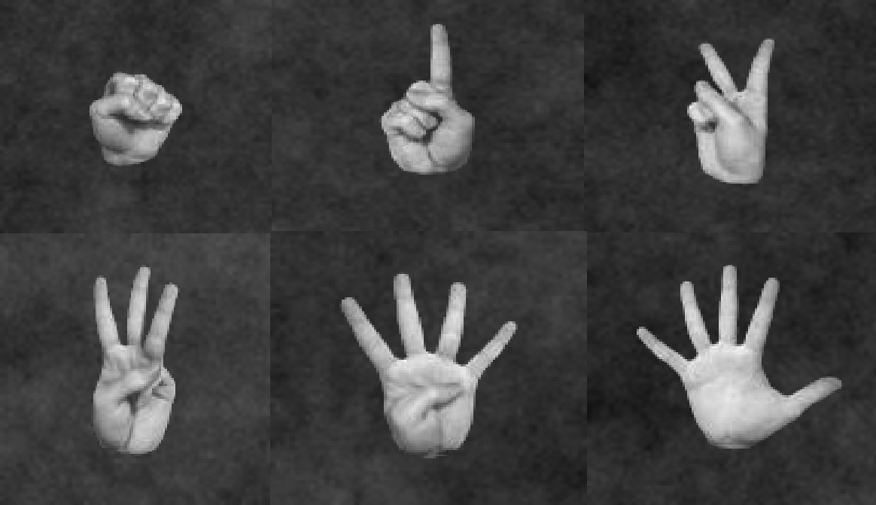
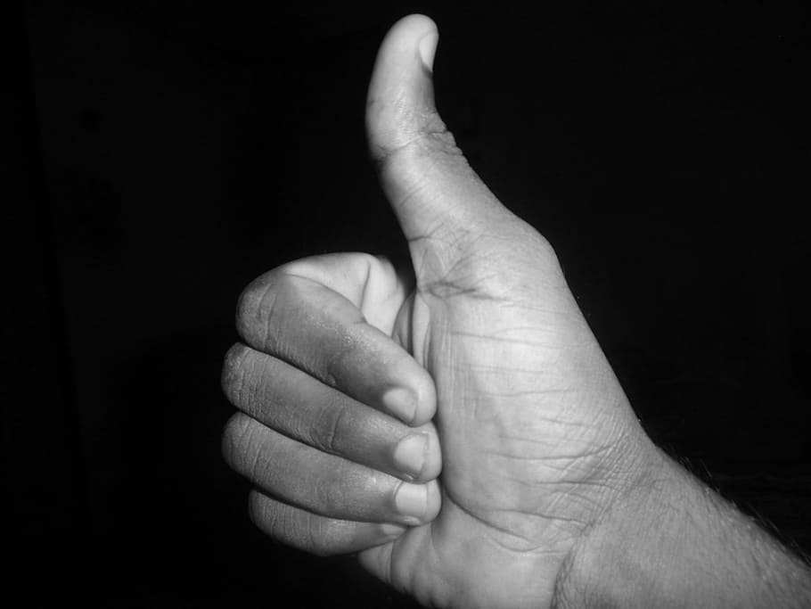
Order-Mate
Image recognition
Members:
Ananthi Periasami
Simon Sakkal
Shahadath Farouk
Yohei Waki

Slide 2
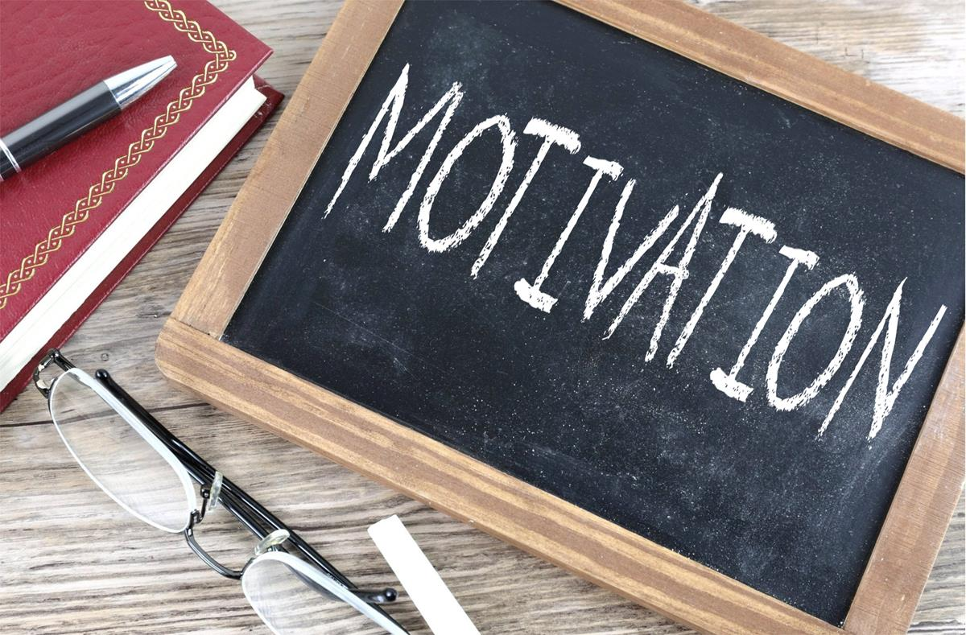
MOTIVATION AND SUMMARY
Our group was highly enthusiastic to use machine learning models and libraries to explore image recognition. Our research enabled us to further explore libraries, models and tests to provide an accurate working model.
Summary description
Identify 0,1,2,3,4,5 via image capture [Left and Right hand]
A dataset of 18,000 images of fingers and 12 classes were defined [Kaggle]
CNN model and ResNet 50

Slide 3

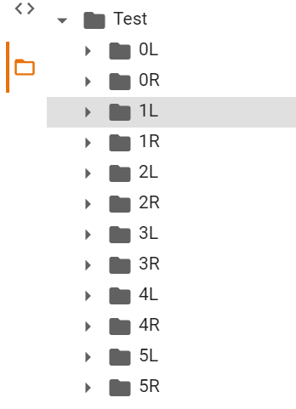
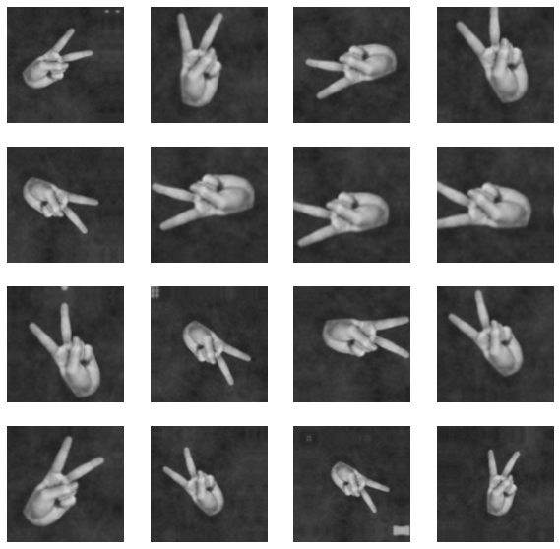
Data Exploration and Summary
Importing key libraries and importing the dataset (using Kaggle)
Tensorflow, Keras, OpenCV
Organizing the dataset into classes and loading the dataset
Train and validate Test data
Data Augmentation
CNN Model
Optimizer = adam, metrics=accuracy
Model prediction
Softmax

Slide 4
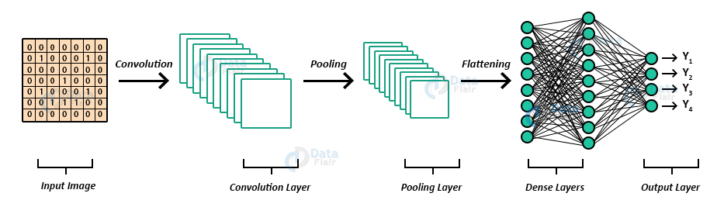
Model Architecture

Slide 5
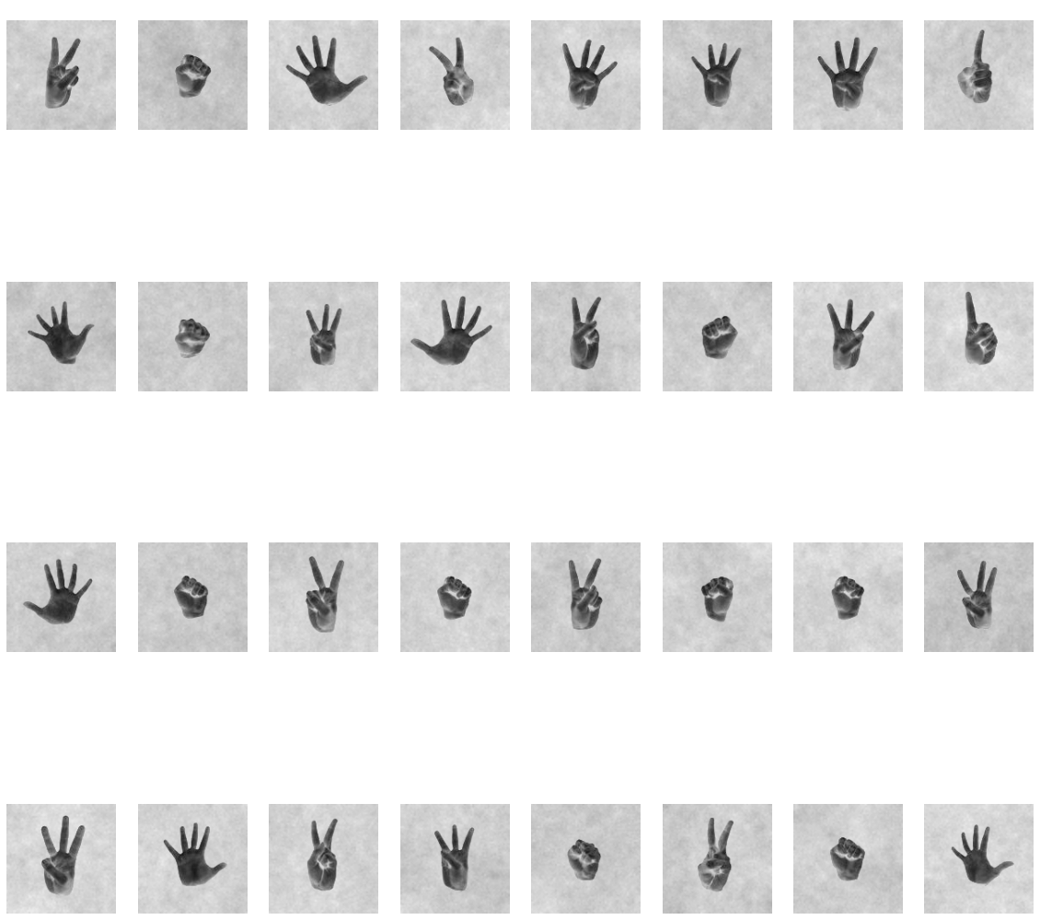
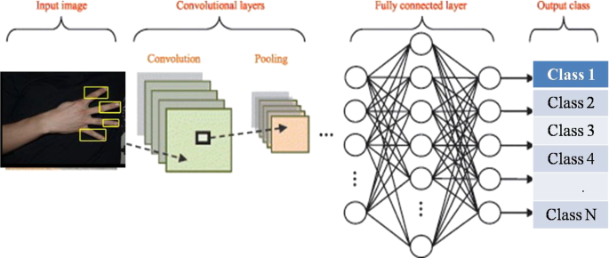
CNN Architecture for fingers
One of the most popular image classification algorithm for machine learning.
Consist of three components
Convolutional layer
Max pooling layer
Flatten and dense layer

Slide 6
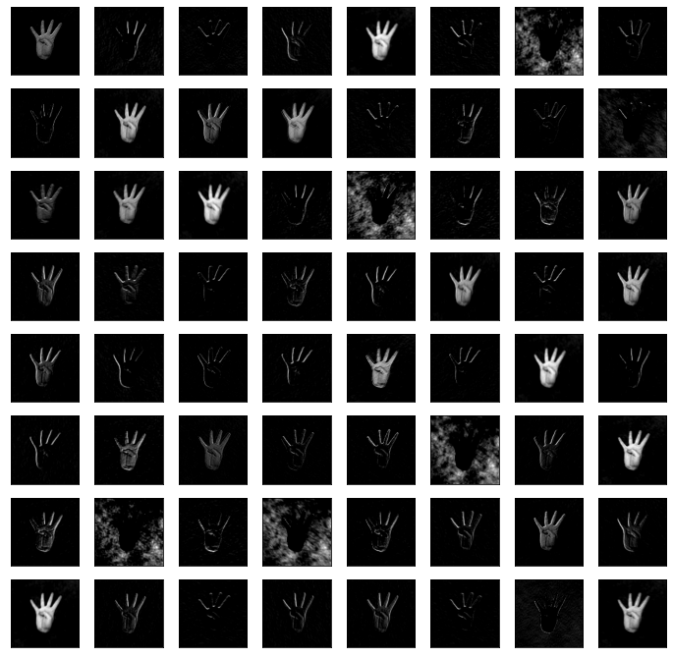
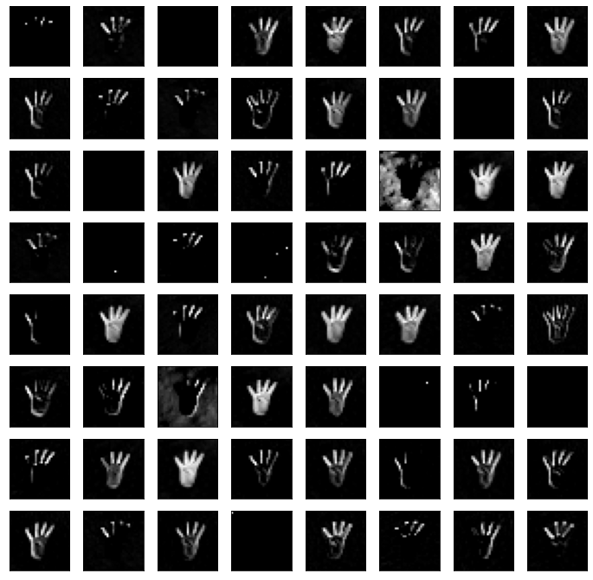
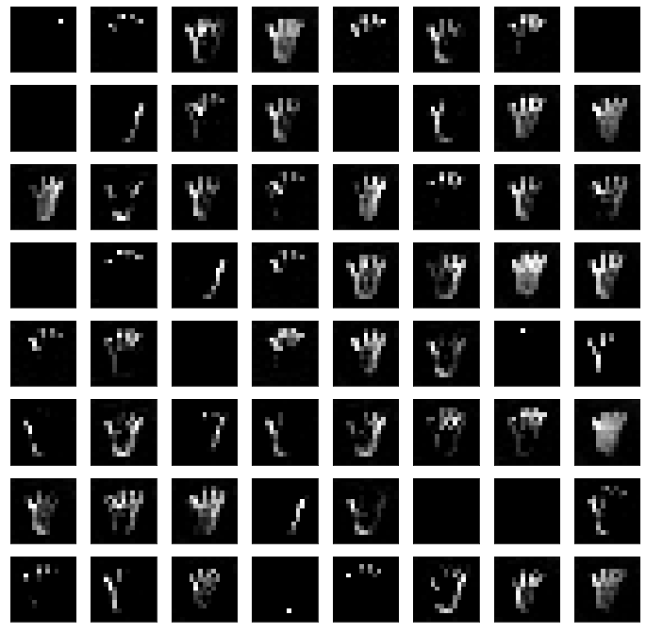
CNN Architecture
Visualization of convolutional filter
1st Convolutional Layer
2nd Convolutional Layer
3rd Convolutional Layer

Slide 7
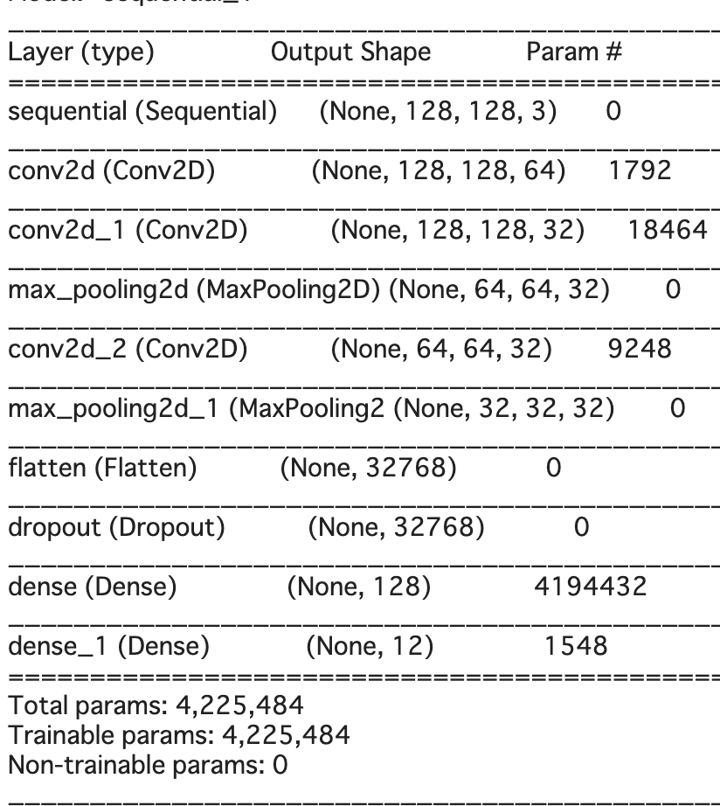
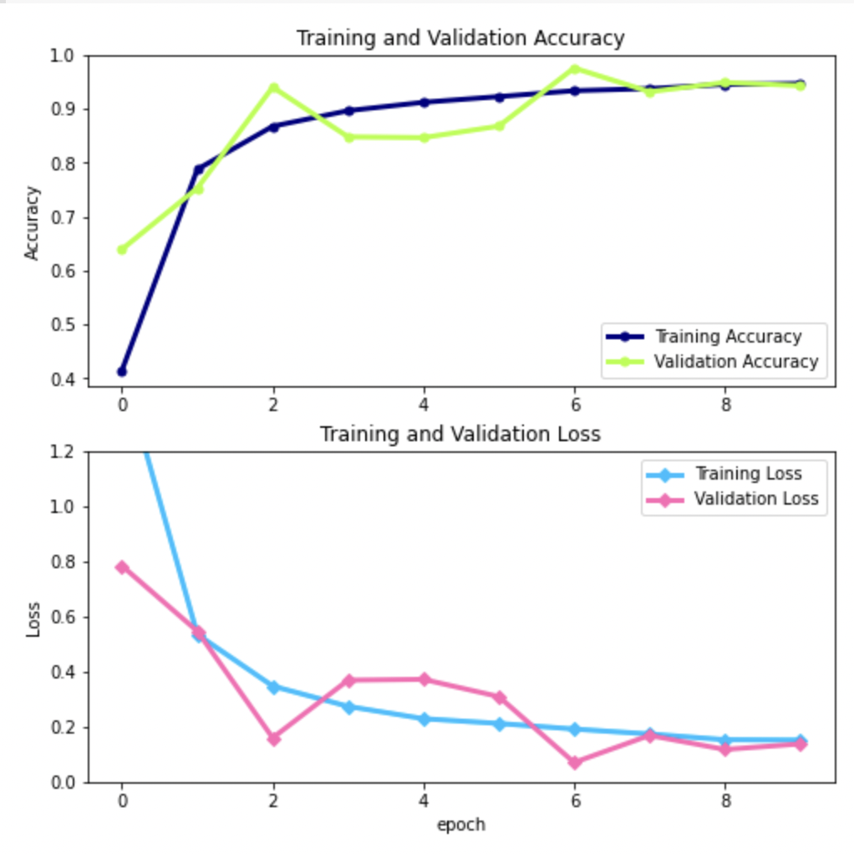
Convolutional Neural Network Architecture
Outcome
Trained over 10 Epochs.
Some differences but validation data is in line with the training training data is a good fit.

Slide 8
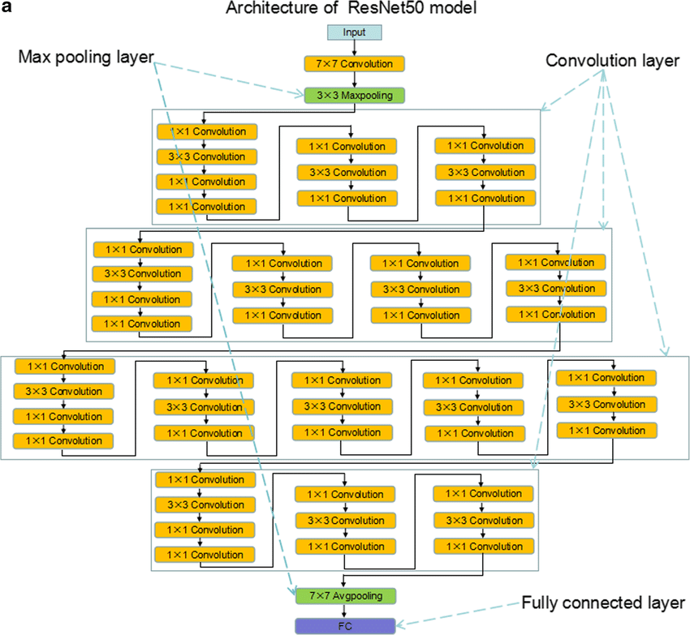
ResNet 50 (CNN) Model
ResNet 50 (CNN) Model is a
CNN that is 50 layers deep.
(48 Convolutional layers,
1 Max Pooling layer,
1 Average pooling layer)
ResNet 50 (CNN) Model contains
Pretrained data of more than
1 million images from ImageNet
Database.
Winner of ImageNet Challenge in 2015

Slide 9
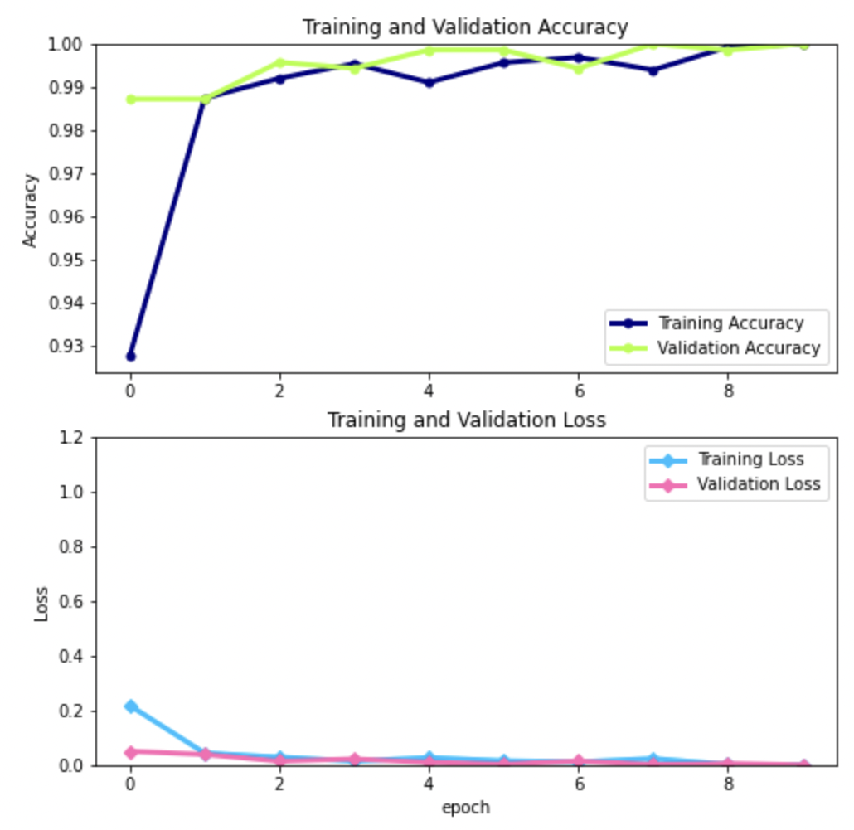
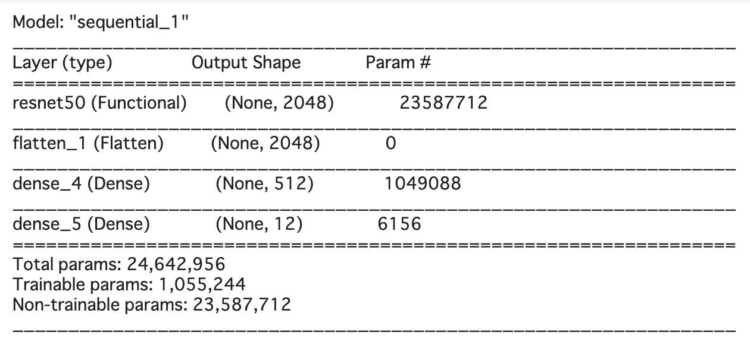
ResNet 50 (CNN) Model
Outcome:
99.9 % accuracy
0.0048 % loss
Minimal differences
between training and
validation data.

Slide 10
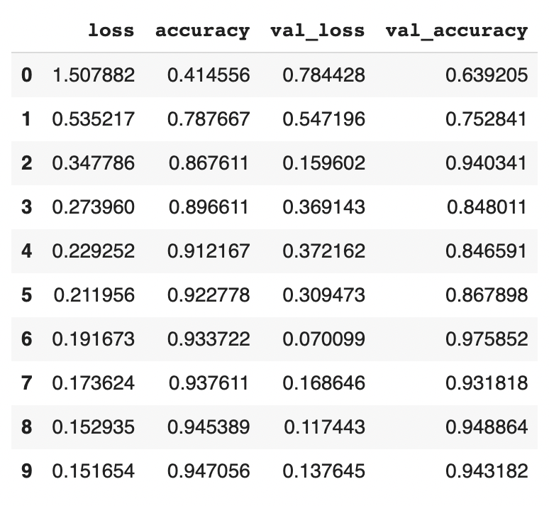
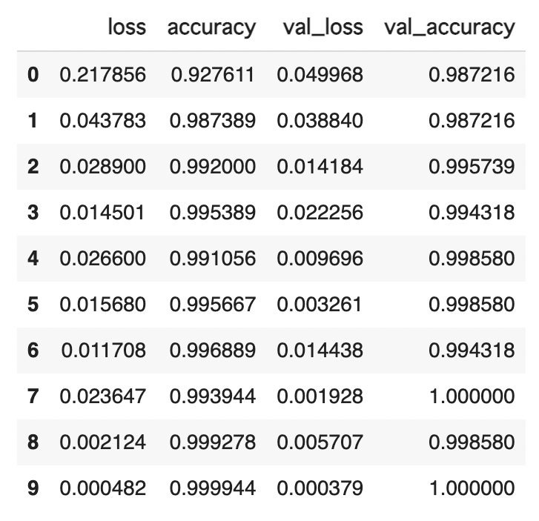
Our CUSTOM model vs. ResNet 50 Model
Custom
ResNet 50

Slide 11
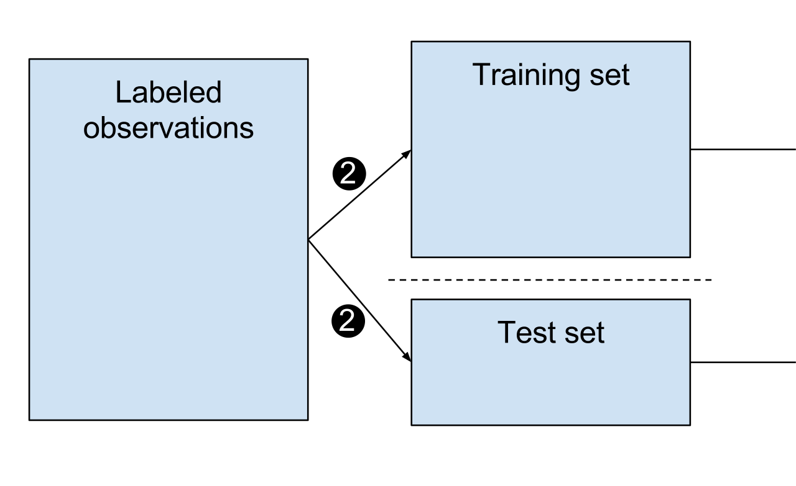
Implementation of Train and Test
The Model was trained and tested with Kaggle dataset of images for count of fingers from 1 to 5 on both Left and Right hand images.
This model is saved as ‘Fingers.h5’ in google drive to mount it on Google Colab for project live implementation purposes. Furthermore, the saved model is loaded using TensorFlow Keras load_model method. By saving the model in google drive and using mount methods in notebook improved the GPU run time efficiency.
The user input image is then passed on to this model to predict the result.

Slide 12


Model Evaluation - user input
We capture live image as the user input from the browser using Python Display and Javascript Video and Canvas elements are created on the fly and the live photo is taken from users device camera which is then displayed using CV2 (openCV) library
OpenCV Python is a library of Python bindings designed to solve computer vision problems. Imread method displays the picture on to the browser
Because we have developed this in Google Colab, instead of openCV we have imported “cv2_imshow” from google colab patches as there were limitations
The captured live image is converted into black and white image using “cvtColour” method - this conversion is needed as the model is trained with black and white image dataset from kaggle and then the image size is also adjusted for the input image similar to that of the trained dataset.

Slide 13
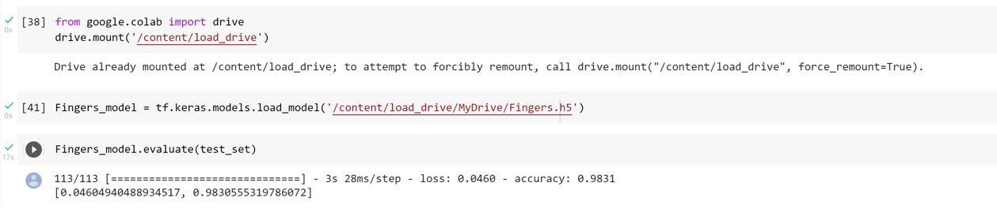
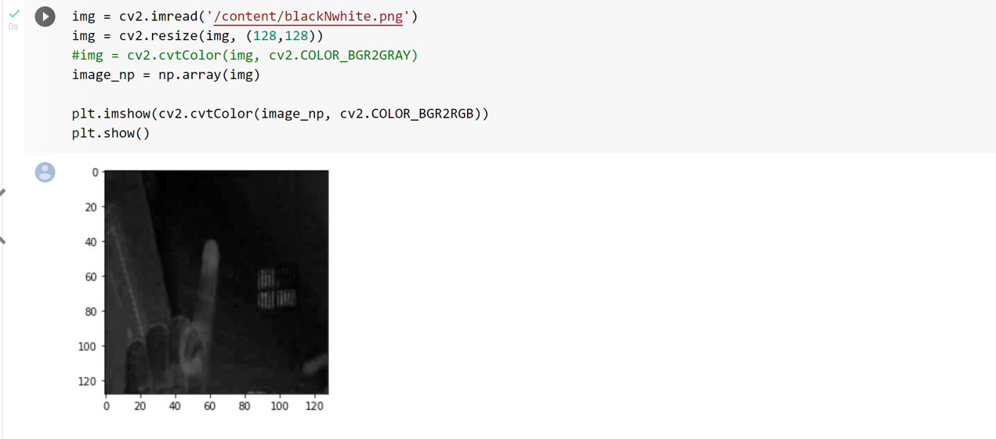
Loading the saved model

Slide 14
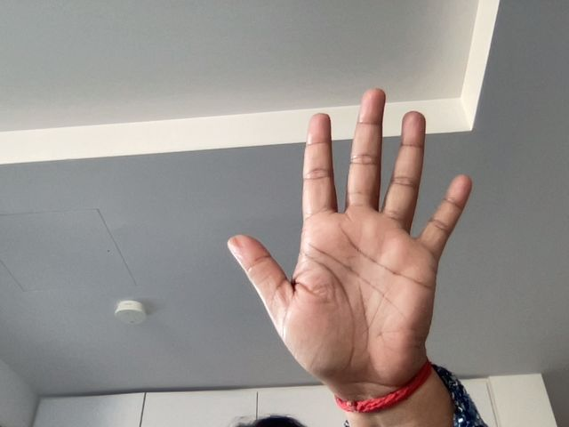
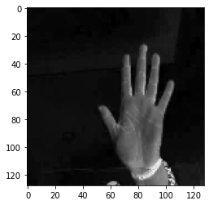
Model Prediction
Captured Live Photo
Converted for Prediction
Model Predicted as 5 fingers on the Left Hand - 5L

Slide 15
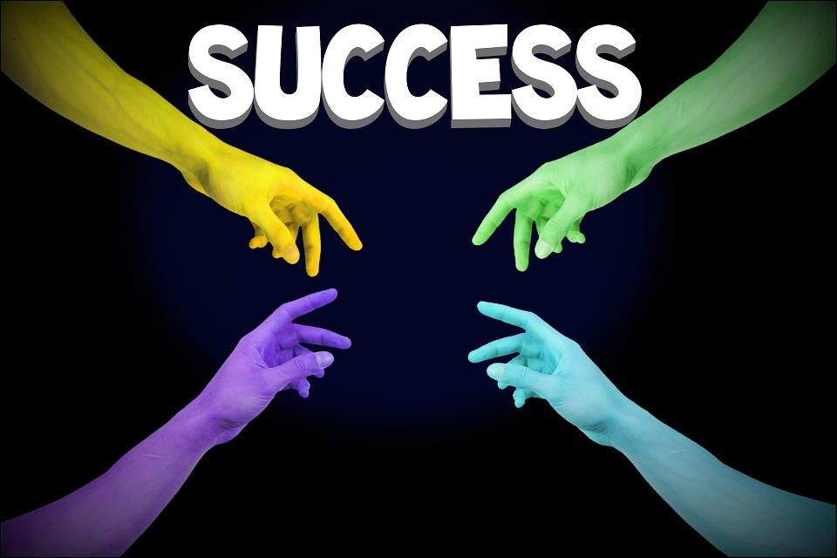
Model Prediction

Slide 16

Summary
Challenges:
Limitation with colour images since the dataset is trained using grayscale images
Colab limitations - GPU
Uploading the model for every session was time consuming and figured to mount the drive and access our model via Google Drive.
Prediction difficulties depends on the layers of modelling which we found challenging tweaking for accuracy and precision

Slide 17
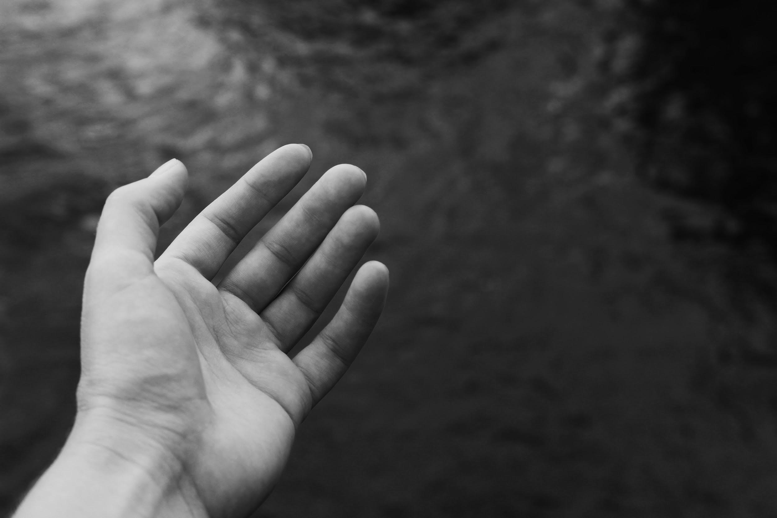
Thank You

Slide 18

Questions and Answers

Slide 19
